Slide 1

Chapter 5
Monitors &
Condition Synchronization

Slide 2
monitors & condition synchronization
Concepts: monitors:
encapsulated data + access procedures
mutual exclusion + condition synchronization
single access procedure active in the monitor
nested monitors
Models: guarded actions
Practice: private data and synchronized methods (exclusion).
wait(), notify() and notifyAll() for condition synch.
single thread active in the monitor at a time

Slide 3
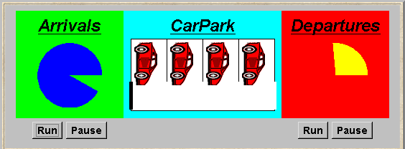
5.1 Condition synchronization
A controller is required for a carpark, which only permits cars to enter when the carpark is not full and does not permit cars to leave when there are no cars in the carpark. Car arrival and departure are simulated by separate threads.

Slide 4
carpark model
Events or actions of interest?
  arrive and depart
Identify processes.
  arrivals, departures and carpark control
Define each process and interactions (structure).
CARPARK
ARRIVALS
arrive
CARPARK
depart
DEPARTURES
CONTROL

Slide 5
carpark model
CARPARKCONTROL(N=4) = SPACES[N],
SPACES[i:0..N] = (when(i>0) arrive->SPACES[i-1]
|when(i<N) depart->SPACES[i+1]
).
ARRIVALS = (arrive->ARRIVALS).
DEPARTURES = (depart->DEPARTURES).
||CARPARK =
(ARRIVALS||CARPARKCONTROL(4)||DEPARTURES).
Guarded actions are used to control arrive and depart. LTS?

Slide 6
carpark program
Model - all entities are processes interacting by actions
Program - need to identify threads and monitors
  thread - active entity which initiates (output) actions
  monitor - passive entity which responds to (input) actions.
For the carpark?
CARPARK
ARRIVALS
arrive
CARPARK
depart
DEPARTURES
CONTROL

Slide 7
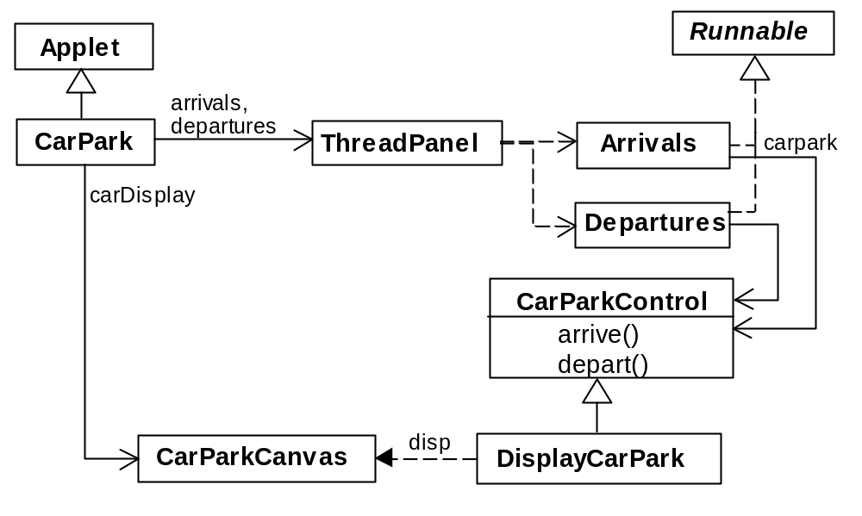
carpark program - class diagram
We have omitted DisplayThread and GraphicCanvas threads managed by ThreadPanel.

Slide 8
carpark program
Arrivals and Departures implement Runnable, CarParkControl provides the control (condition synchronization).
Instances of these are created by the start() method of the CarPark applet :
public void start() {
CarParkControl c =
new DisplayCarPark(carDisplay,Places);
arrivals.start(new Arrivals(c));
departures.start(new Departures(c));
}

Slide 9
carpark program - Arrivals and Departures threads
class Arrivals implements Runnable {
CarParkControl carpark;
Arrivals(CarParkControl c) {carpark = c;}
public void run() {
try {
while(true) {
ThreadPanel.rotate(330);
carpark.arrive();
ThreadPanel.rotate(30);
}
} catch (InterruptedException e){}
}
}
Similarly Departures which calls carpark.depart().
How do we implement the control of CarParkControl?

Slide 10
Carpark program - CarParkControl monitor
class CarParkControl {
protected int spaces;
protected int capacity;
CarParkControl(int n)
{capacity = spaces = n;}
synchronized void arrive() {
… --spaces; …
}
synchronized void depart() {
… ++spaces; …
}
}
mutual exclusion by synch methods
condition synchronization?
block if full? (spaces==0)
block if empty? (spaces==N)

Slide 11
condition synchronization in Java
Java provides a thread wait set per monitor (actually per object) with the following methods:
public final void notify()
Wakes up a single thread that is waiting on this object's wait set.
public final void notifyAll()
Wakes up all threads that are waiting on this object's wait set.
public final void wait()
throws InterruptedException
Waits to be notified by another thread. The waiting thread
releases the synchronization lock associated with the monitor.
When notified, the thread must wait to reacquire the monitor
before resuming execution.

Slide 12
condition synchronization in Java
We refer to a thread entering a monitor when it acquires the mutual exclusion lock associated with the monitor and exiting the monitor when it releases the lock.
Wait() - causes the thread to exit the monitor,
permitting other threads to enter the monitor.
Monitor
Thread A
Thread B
data
wait()
notify()

Slide 13
monitor lock
Thread C
Thread F
Thread F
Thread E
Thread E
Thread B
Monitor
Thread B
data
Thread A
wait()
notify()
Thread C
Thread A
Thread A
wait

Slide 14
condition synchronization in Java
FSP: when cond act -> NEWSTAT
Java: public synchronized void act()
throws InterruptedException
{
while (!cond) wait();
// modify monitor data
notifyAll()
}
The while loop is necessary to retest the condition cond to ensure that cond is indeed satisfied when it re-enters the monitor.
notifyall() is necessary to awaken other thread(s) that may be waiting to enter the monitor now that the monitor data has been changed.

Slide 15
CarParkControl - condition synchronization
class CarParkControl {
protected int spaces;
protected int capacity;
CarParkControl(int n)
{capacity = spaces = n;}
synchronized void arrive() throws InterruptedException {
while (spaces==0) wait();
--spaces;
notifyAll();
}
synchronized void depart() throws InterruptedException {
while (spaces==capacity) wait();
++spaces;
notifyAll();
}
}
Is it safe to use notify() here rather than notifyAll()?

Slide 16
models to monitors - summary
Active entities (that initiate actions) are implemented as threads. Passive entities (that respond to actions) are implemented as monitors.
  Each guarded action in the model of a monitor is implemented as a synchronized method which uses a while loop and wait() to implement the guard. The while loop condition is the negation of the model guard condition.
Changes in the state of the monitor are signaled to waiting threads using notify() or notifyAll().

Slide 17
5.2 Semaphores
Semaphores are widely used for dealing with inter-process synchronization in operating systems. Semaphore s is an integer variable that can take only non-negative values.
The only operations permitted on s are up(s) and down(s). Blocked processes are held in a FIFO queue.
down(s): if s >0 then
    decrement s
    else
    block execution of the calling process
up(s): if processes blocked on s then
    awaken one of them
else
    increment s

Slide 18
modeling semaphores
To ensure analyzability, we only model semaphores that take a finite range of values. If this range is exceeded then we regard this as an ERROR. N is the initial value.
const Max = 3
range Int = 0..Max
SEMAPHORE(N=0) = SEMA[N],
SEMA[v:Int] = (up->SEMA[v+1]
|when(v>0) down->SEMA[v-1]
),
SEMA[Max+1] = ERROR.
LTS?

Slide 19
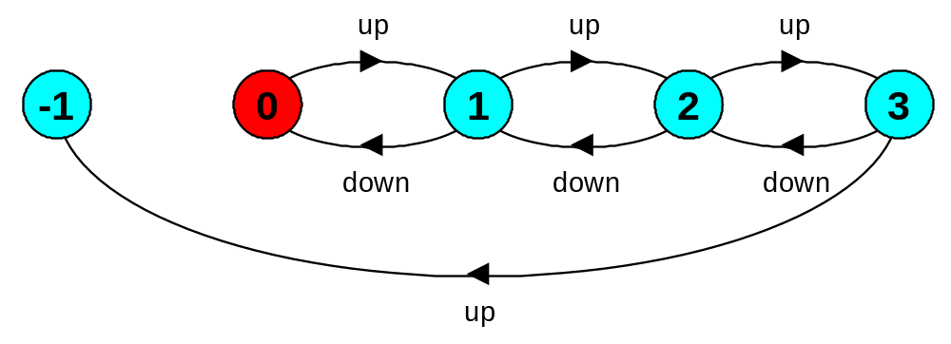
modeling semaphores
Action down is only accepted when value v of the semaphore is greater than 0.
Action up is not guarded.
Trace to a violation:
up → up → up → up

Slide 20
semaphore demo - model
Three processes p[1..3] use a shared semaphore mutex to ensure mutually exclusive access (action critical) to some resource.
LOOP = (mutex.down->critical->mutex.up->LOOP).
||SEMADEMO = (p[1..3]:LOOP
||{p[1..3]}::mutex:SEMAPHORE(1)).
For mutual exclusion, the semaphore initial value is 1. Why?
Is the ERROR state reachable for SEMADEMO?
Is a binary semaphore sufficient (i.e. Max=1) ?
LTS?

Slide 21
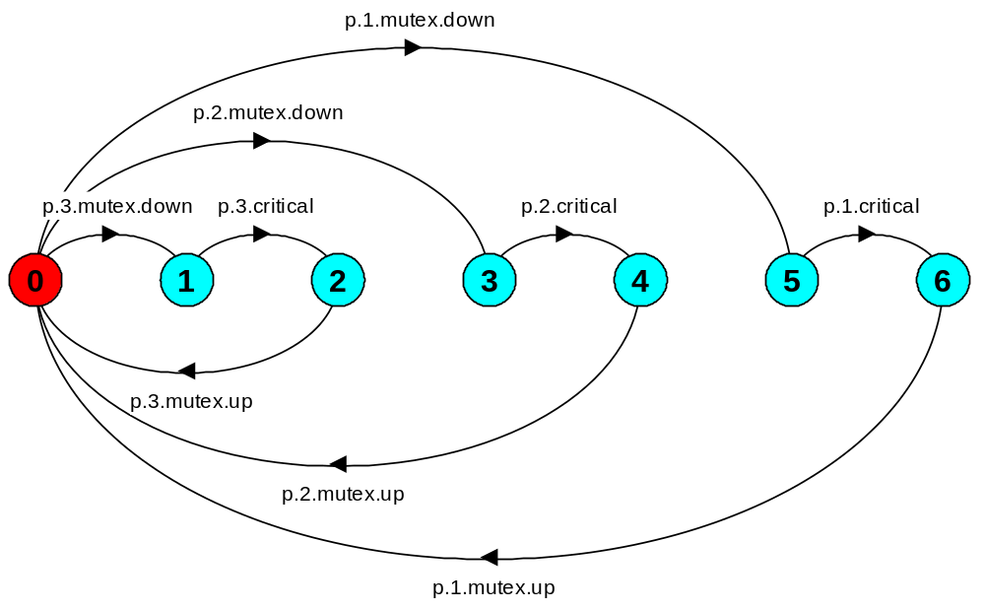
semaphore demo - model

Slide 22
semaphores in Java
Semaphores are passive objects, therefore implemented as monitors.
(In practice, semaphores are a low-level mechanism often used in implementing the higher-level monitor construct.)
public class Semaphore {
private int value;
public Semaphore (int initial)
{value = initial;}
synchronized public void up() {
++value;
notifyAll();
}
synchronized public void down()
throws InterruptedException {
while (value== 0) wait();
--value;
}
}
Is it safe to use notify() here rather than notifyAll()?

Slide 23
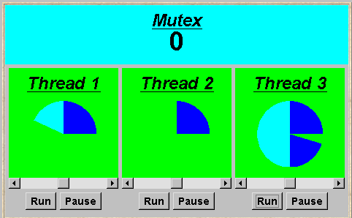
SEMADEMO display
current semaphore value
thread 1 is executing critical actions.
thread 2 is blocked waiting.
thread 3 is executing non-critical actions.

Slide 24
SEMADEMO
What if we adjust the time that each thread spends in its critical section ?
large resource requirement - more conflict?
(eg. more than 67% of a rotation)?
small resource requirement - no conflict?
  (eg. less than 33% of a rotation)?
Hence the time a thread spends in its critical section should be kept as short as possible.

Slide 25
SEMADEMO program - revised ThreadPanel class
public class ThreadPanel extends Panel {
// construct display with title and rotating arc color c
public ThreadPanel(String title, Color c) {…}
// hasSlider == true creates panel with slider
public ThreadPanel
(String title, Color c, boolean hasSlider) {…}
// rotate display of currently running thread 6 degrees
// return false when in initial color, return true when in second color
public static boolean rotate()
throws InterruptedException {…}
// rotate display of currently running thread by degrees
public static void rotate(int degrees)
throws InterruptedException {…}
// create a new thread with target r and start it running
public void start(Runnable r) {…}
// stop the thread using Thread.interrupt()
public void stop() {…}
}

Slide 26
SEMADEMO program - MutexLoop
class MutexLoop implements Runnable {
Semaphore mutex;
MutexLoop (Semaphore sema) {mutex=sema;}
public void run() {
try {
while(true) {
while(!ThreadPanel.rotate());
mutex.down(); // get mutual exclusion
while(ThreadPanel.rotate()); //critical actions
mutex.up(); //release mutual exclusion
}
} catch(InterruptedException e){}
}
}
Threads and semaphore are created by the applet start() method.
ThreadPanel.rotate() returns false while executing non-critical actions (dark color) and true otherwise.

Slide 27
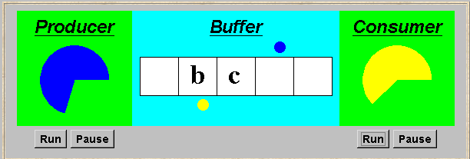
5.3 Bounded Buffer
A bounded buffer consists of a fixed number of slots. Items are put into the buffer by a producer process and removed by a consumer process. It can be used to smooth out transfer rates between the producer and consumer.
(see car park example)

Slide 28
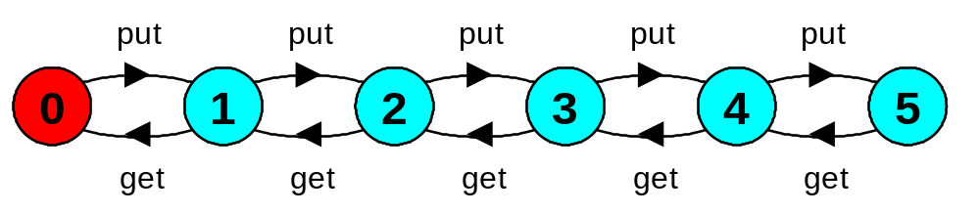
bounded buffer - a data-independent model
BOUNDEDBUFFER
PRODUCER
put
BUFFER
get
CONSUMER
The behaviour of BOUNDEDBUFFER is independent of the actual data values, and so can be modelled in a data-independent manner.
LTS:

Slide 29
bounded buffer - a data-independent model
BUFFER(N=5) = COUNT[0],
COUNT[i:0..N]
= (when (i<N) put->COUNT[i+1]
|when (i>0) get->COUNT[i-1]
).
PRODUCER = (put->PRODUCER).
CONSUMER = (get->CONSUMER).
||BOUNDEDBUFFER = (PRODUCER||BUFFER(5)||CONSUMER).

Slide 30
bounded buffer program - buffer monitor
public interface Buffer <E> {…}
class BufferImpl <E> implements Buffer <E> {
…
public synchronized void put(E o)
throws InterruptedException {
while (count==size) wait();
buf[in] = o; ++count; in=(in+1)%size;
notifyAll();
}
public synchronized E get()
throws InterruptedException {
while (count==0) wait();
E o =buf[out];
buf[out]=null; --count; out=(out+1)%size;
notifyAll();
return (o);
}
}
We separate the interface to permit an alternative implementation later.
Is it safe to use notify() here rather than notifyAll()?

Slide 31
bounded buffer program - producer process
class Producer implements Runnable {
Buffer buf;
String alphabet= "abcdefghijklmnopqrstuvwxyz";
Producer(Buffer b) {buf = b;}
public void run() {
try {
int ai = 0;
while(true) {
ThreadPanel.rotate(12);
buf.put(alphabet.charAt(ai));
ai=(ai+1) % alphabet.length();
ThreadPanel.rotate(348);
}
} catch (InterruptedException e){}
}
}
Similarly Consumer which calls buf.get().

Slide 32
5.4 Nested Monitors
Suppose that, in place of using the count variable and condition synchronization directly, we instead use two semaphores full and empty to reflect the state of the buffer.
class SemaBuffer <E> implements Buffer <E> {
…
Semaphore full; //counts number of items
Semaphore empty; //counts number of spaces
SemaBuffer(int size) {
this.size = size; buf =(E[])new Object[size];
full = new Semaphore(0);
empty= new Semaphore(size);
}
…
}

Slide 33
nested monitors - bounded buffer program
synchronized public void put(E o)
throws InterruptedException {
empty.down();
buf[in] = o;
++count; in=(in+1)%size;
full.up();
}
synchronized public E get()
throws InterruptedException{
full.down();
E o =buf[out]; buf[out]=null;
--count; out=(out+1)%size;
empty.up();
return (o);
}
Does this behave as desired?
empty is decremented during a put operation, which is blocked if empty is zero; full is decremented by a get operation, which is blocked if full is zero.

Slide 34
nested monitors - bounded buffer model
const Max = 5
range Int = 0..Max
SEMAPHORE ...as before...
BUFFER = (put -> empty.down ->full.up ->BUFFER
|get -> full.down ->empty.up ->BUFFER
).
PRODUCER = (put -> PRODUCER).
CONSUMER = (get -> CONSUMER).
||BOUNDEDBUFFER = (PRODUCER|| BUFFER || CONSUMER
||empty:SEMAPHORE(5)
||full:SEMAPHORE(0)
)@{put,get}.
Does this behave as desired?

Slide 35
nested monitors - bounded buffer model
LTSA analysis predicts a possible DEADLOCK:
    Composing
    potential DEADLOCK
    States Composed: 28 Transitions: 32 in 60ms
    Trace to DEADLOCK:
    get
The Consumer tries to get a character, but the buffer is empty. It blocks and releases the lock on the semaphore full. The Producer tries to put a character into the buffer, but also blocks. Why?
This situation is known as the nested monitor problem.

Slide 36
nested monitors - bounded buffer model
synchronized public Object get()
throws InterruptedException{
full.down(); // if no items, block!
...
}
get
down
full
full
full
buffer
buffer
wait
put
empty

Slide 37
nested monitors - revised bounded buffer program
The only way to avoid it in Java is by careful design. In this example, the deadlock can be removed by ensuring that the monitor lock for the buffer is not acquired until after semaphores are decremented.
public void put(E o)
throws InterruptedException {
empty.down();
synchronized(this){
buf[in] = o; ++count; in=(in+1)%size;
}
full.up();
}

Slide 38
nested monitors - revised bounded buffer model
BUFFER = (put -> BUFFER
|get -> BUFFER
).
PRODUCER =(empty.down->put->full.up->PRODUCER).
CONSUMER =(full.down->get->empty.up->CONSUMER).
The semaphore actions have been moved to the producer and consumer. This is exactly as in the implementation where the semaphore actions are outside the monitor .
Does this behave as desired?
Minimized LTS?

Slide 39
5.5 Monitor invariants
An invariant for a monitor is an assertion concerning the variables it encapsulates. This assertion must hold whenever there is no thread executing inside the monitor i.e. on thread entry to and exit from a monitor .
CarParkControl Invariant: 0 ≤ spaces ≤ N
Semaphore Invariant: 0 ≤ value
Buffer Invariant: 0 ≤ count ≤ size
    and 0 ≤ in < size
    and 0 ≤ out< size
    and in = (out + count) modulo size
Invariants can be helpful in reasoning about correctness of monitors using a logical proof-based approach. Generally we prefer to use a model-based approach amenable to mechanical checking .

Slide 40
Summary
Concepts
  monitors: encapsulated data + access procedures
    mutual exclusion + condition synchronization
  nested monitors
Model
  guarded actions
Practice
  private data and synchronized methods in Java
  wait(), notify() and notifyAll() for condition synchronization
  single thread active in the monitor at a time

